Slide 1
The RAD model
Team 1
Team 2
Team 3
Business modelling
Business modelling
Business modelling
Data modelling
Data modelling
Data modelling
Process modelling
Process modelling
Process modelling
Application
Generation
Application
Generation
Application
Generation
Testing & Turnover
Testing & Turnover
Testing & Turnover
http://istqbexamcertification.com/what-is-rad-model-advantages-disadvantages-and-when-to-use-it/

Slide 2
Business modeling – e³-value modeling
Notes:
Welcome to this introduction to the e3-value ontology. My name is Paul Johannesson and I will give an overview of e3-value, its purpose and its basic concepts.

Slide 3
What does e3-value Answer?
Typical questions to be answered by e³-value:
Which organizations are needed to offer a specific product?
What do they offer each other of economic value?
Who is doing what, and with whom?
What happens if:
We value products differently?
We shift activities from one actor to another?
…
Notes:
More concretely, e3-value helps in formulating and answering a number of questions about actors, value and the exchange of value between actors. For example:
Which organizations, which actors, are needed to offer a specific product or service?
What do these actors offer each other that is of economic value?
What are the different actors doing? And with whom do they cooperate?
We can also answer what-if questions to evaluate and analyse the business idea, for example:
What happens if different actors value products differently?
What happens if we shift activities from one actor to another?
In order to answer questions like these, e3-value provides a small number of concepts for building models. These models can also be shown graphically, and we will start by looking at an example model.

Slide 4
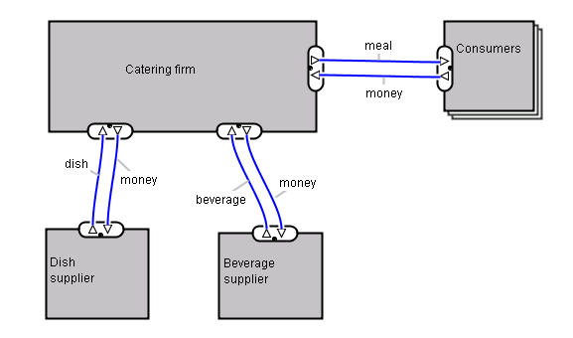
An e³-value model
actor
market segment
value
object
value exchange
value interface
value port
Notes:
This figure shows a simple e3-value model. It is about a catering company that sells meals to consumers and purchases dishes and beverages from suppliers. The model shows a number of actors and exchanges of resources between these actors. Most of the concepts in e3-value are represented in this model. There are actors, like the caterer and suppliers, shown by rectangles. There are groups of actors, called market segments, shown by stacked rectangles. There are value objects, like dishes and meals and money, which the actors offer and transfer to each other. The offering of value objects are shown by value ports, small triangles on the border of an actor, indicating whether the actor provides or requests a value object. A number of value ports are grouped together into value interfaces. And finally, there are exchanges of value objects between the actors, shown by lines between value ports. We will now look in more detail at each of these concepts.

Slide 5
The RAD model
Team 1
Team 2
Team 3
Business modelling
Business modelling
Business modelling
Data modelling
Data modelling
Data modelling
Process modelling
Process modelling
Process modelling
Application
Generation
Application
Generation
Application
Generation
Testing & Turnover
Testing & Turnover
Testing & Turnover
http://istqbexamcertification.com/what-is-rad-model-advantages-disadvantages-and-when-to-use-it/

Slide 6
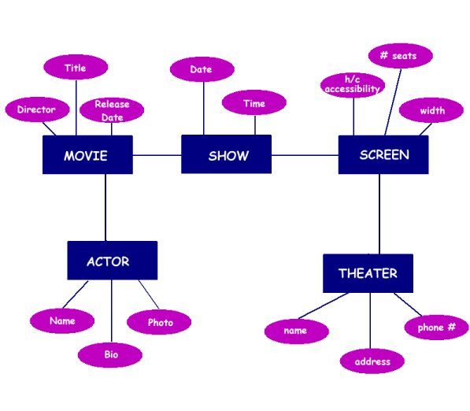
Data Model - example

Slide 7
The RAD model
Team 1
Team 2
Team 3
Business modelling
Business modelling
Business modelling
Data modelling
Data modelling
Data modelling
Process modelling
Process modelling
Process modelling
Application
Generation
Application
Generation
Application
Generation
Testing & Turnover
Testing & Turnover
Testing & Turnover
http://istqbexamcertification.com/what-is-rad-model-advantages-disadvantages-and-when-to-use-it/

Slide 8
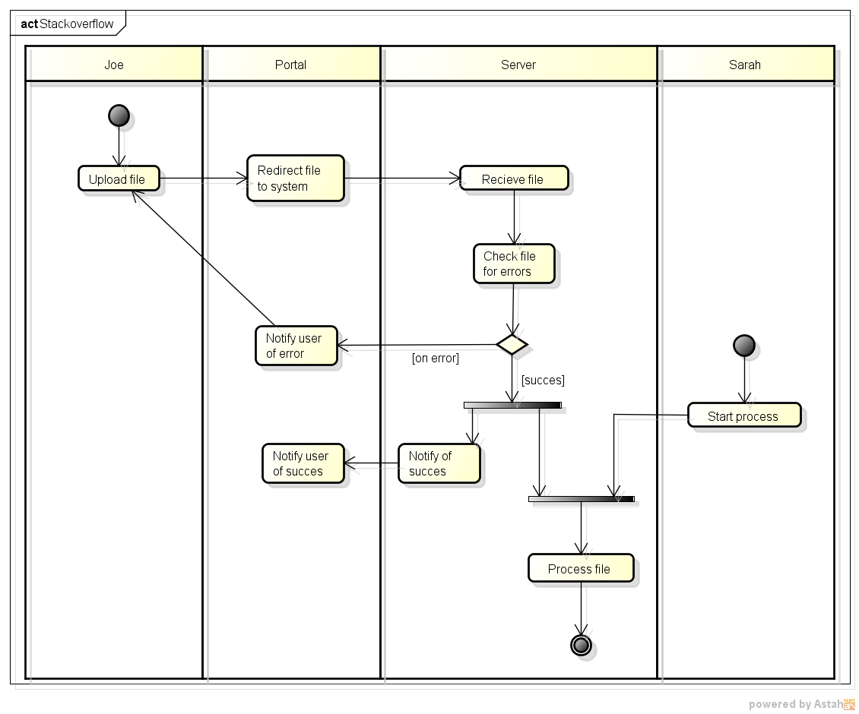
Process Model - Example

Slide 9
Specialized Process Models
Component-based development
The formal methods model

Slide 10
The Component based model
This incorporates many of the characteristics of the spiral model.
It is evolutionary in nature, demanding an iterative approach to the creation of software.
However, it composes applications from pre-packaged software components.

Slide 11
Component based development
Identify candidate components
Construct nth iteration of system
Look up components in library
Put new components in library
Extract components if available
Build components if unavailable
Component Assembly model – engineering construction and release activity (Pressman 1997)

Slide 12
The Formal Method Model
Encompasses a set of activities that leads to formal mathematical specification of computer software
Specify, develop and verify a computer based system by applying a rigorous mathematical notation.

Slide 13
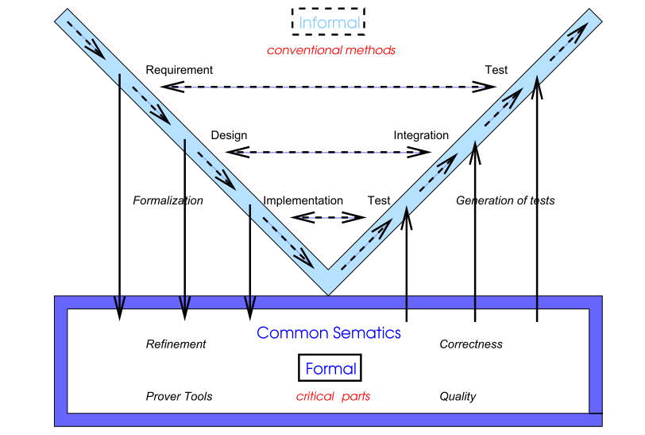
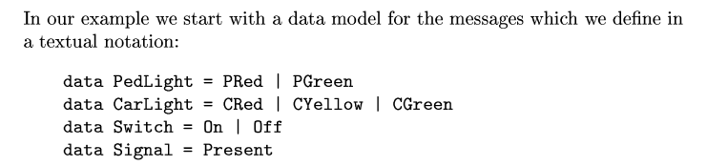
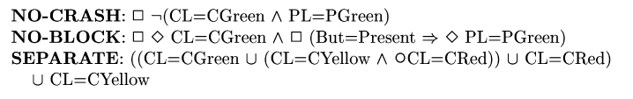
The Formal Method Model

Slide 14
Usage
Used to create a error-free software
Critical and sensitive software
Development of Ethernet switches, routing protocols, and security applications

Slide 15
Disadvantages
Quiet expensive and time consuming
Extensive Training required
Difficult to communicate for technically unsophisticated customer

Slide 16
Conclusion
There are a variety of process models, each of which can be used successfully.
Once a process model has been used to develop a system, documentation style, organisation and structure should either remain in the format of that process model, or all be converted to a different process model.
This is particularly important where automated tools are used.

Slide 17
Examples
Question
You have been appointed a project manager within an information systems organization. Your job is to build an application that is quite similar to others your team has built, although this one is larger and more complex. Requirements have been thoroughly documented by the customer. What software process model(s) would you choose and why? Explain in detail.

Slide 18
Examples
Question
You have been appointed a project manager within an information systems organization. Your job is to build an application that is quite similar to others your team has built, although this one is larger and more complex. Requirements have been thoroughly documented by the customer. What software process model(s) would you choose and why? Explain in detail.

Slide 19
Examples
Question
You have been appointed a project manager for a small software products company. Your job is to build a breakthrough product that combines virtual reality hardware with state-of-art software. Because competition for the home entertainment market is intense, there is significant pressure to get the job done. What software process model(s) would you choose and why? Explain in detail.

Slide 20
Examples
Question
You have been appointed a project manager for a small software products company. Your job is to build a breakthrough product that combines virtual reality hardware with state-of-art software. Because competition for the home entertainment market is intense, there is significant pressure to get the job done. What software process model(s) would you choose and why? Explain in detail.

Slide 21
Examples
Question
You have been appointed a project manager for a major software products company. Your job is to manage the development of the next generation version of its widely used word-processing software. Because competition is intense, tight deadlines have been established and announced. What software process model(s) would you choose and why? Explain in detail.

Slide 22
Examples
Question
You have been asked to develop a small application that analyzes each course offered by a university and reports the average grade obtained in the course (for a given term). What software model(s) would you choose and why? Explain in detail?

Slide 23
Questions?

